Slide 1

ME-4001D – Machine Design-II
Dr.R PRABHU SEKAR,
Assistant Professor,
Mechanical Engineering Department,
National Institute of Technology Calicut.

Slide 2
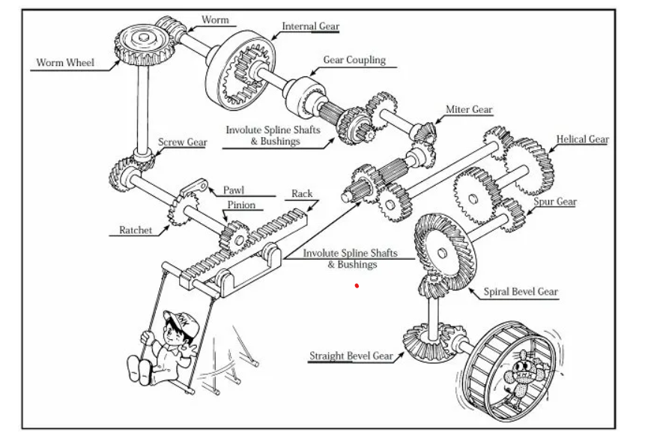
Gears
Gear is a machine elements which are used to transmit the power and motion from one shaft to another shafts.

Slide 3
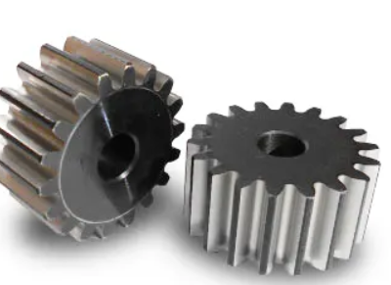
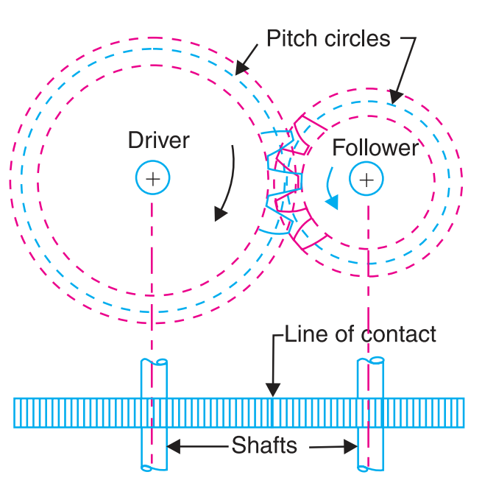
Classification of Gears
(i) Spur Gear
Spur gears belong to the parallel shaft gear group and are cylindrical gears with a tooth line which is straight and parallel to the shaft.
Spur gears are the most widely used gears that can achieve high accuracy with relatively easy production processes.
The larger of the meshing pair is called the gear and smaller is called the pinion.

Slide 4
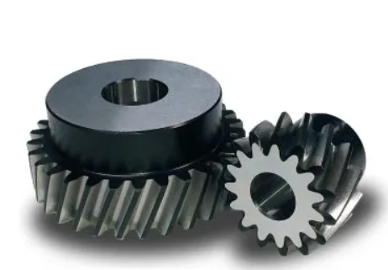
Classification of Gears
(ii) Helical Gear
Helical gears are used with parallel shafts similar to spur gears and teeth are inclined to the tooth axis.
They have better teeth meshing than spur gears and have superior quietness and can transmit higher loads, making them suitable for high speed applications.

Slide 5
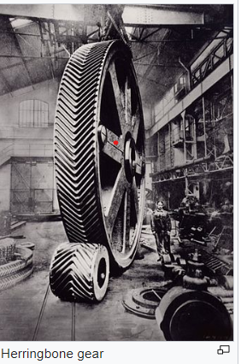
Classification of Gears
When using helical gears, they create thrust force in the axial direction, necessitating the use of thrust bearings.
Helical gears come with right hand and left hand twist requiring opposite hand gears for a meshing pair.
Double helical gear is called as Herringbone gears

Slide 6
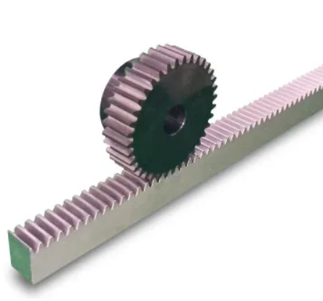
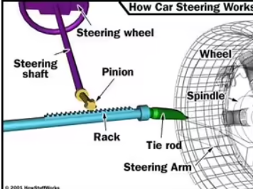
Classification of Gears
(iii) Rack and Pinion
By meshing with a cylindrical gear pinion, it converts rotational motion into linear motion. Gear racks can be broadly divided into straight tooth racks and helical tooth racks.

Slide 7
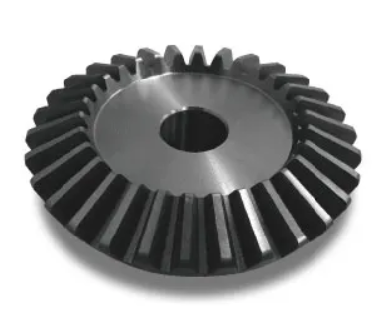
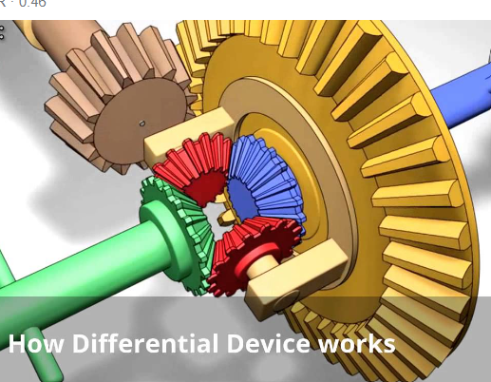
Classification of Gears
(iv) Bevel gear
Bevel gears have a cone shaped appearance and are used to transmit force between two shafts which intersect at one point (intersecting shafts).

Slide 8
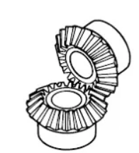
Classification of Gears
Miter Gear
Miter gears are bevel gears with a speed ratio of 1.
They are used to change the direction of power transmission without changing speed.

Slide 9
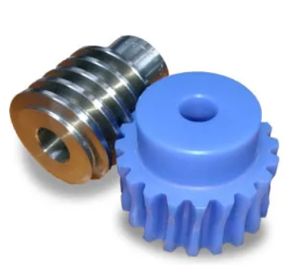
Classification of Gears
(v) Worm Gear
A screw shape cut on a shaft is the worm, the mating gear is the worm wheel, and together on non-intersecting shafts is called a worm gear.

Slide 10
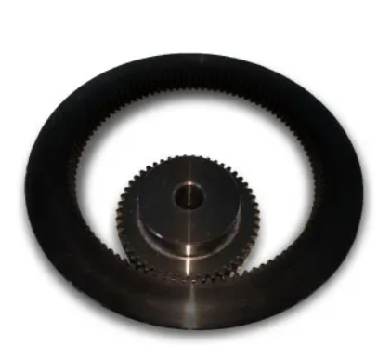
Classification of Gears
(vi) Internal gear
Internal gears have teeth cut on the inside of cylinders and are paired with external gears.
The main use of internal gears are for planetary gear drives.
The rotational directions of the internal and external gears in mesh are the same while they are opposite when two external gears are in mesh.

Slide 11
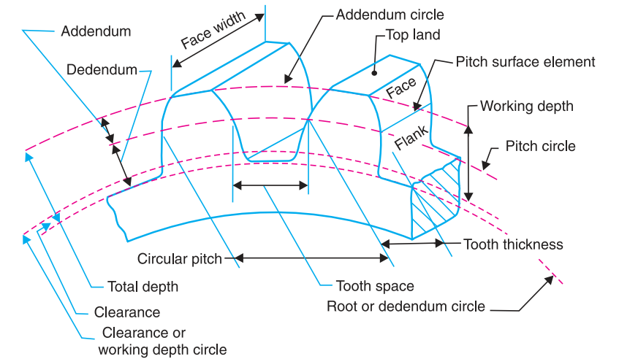
Terms Used in Gears

Slide 12
Terms Used in Gears
1. Pitch circle diameter. It is the diameter of the pitch circle. The size of the gear is usually specified by the pitch circle diameter. It is also known as pitch diameter.
2. Addendum. It is the radial distance of a tooth from the pitch circle to the top of the tooth.
3. Dedendum. It is the radial distance of a tooth from the pitch circle to the bottom of the tooth.
4. Addendum circle. It is the circle drawn through the top of the teeth and is concentric with the pitch circle.
5. Dedendum circle. It is the circle drawn through the bottom of the teeth. It is also called root circle.

Slide 13
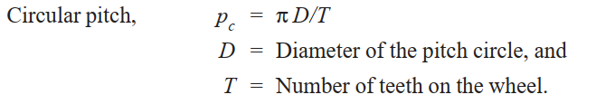

Terms Used in Gears
6. Circular pitch. It is the distance measured on the circumference of the pitch circle from a point of one tooth to the corresponding point on the next tooth.
7. Module. It is the ratio of the pitch circle diameter in millimeters to the number of teeth. It is usually denoted by m.

Slide 14
Terms Used in Gears
8. Clearance. It is the radial distance from the top of the tooth to the bottom of the tooth, in a meshing gear. A circle passing through the top of the meshing gear is known as clearance circle.
9. Total depth. It is the radial distance between the addendum and the dedendum circles of a gear. It is equal to the sum of the addendum and dedendum.
10. Working depth. It is the radial distance from the addendum circle to the clearance circle. It is equal to the sum of the addendum of the two meshing gears.
11. Tooth thickness. It is the width of the tooth measured along the pitch circle.

Slide 15
Terms Used in Gears
Terms Used in Gears
12. Tooth space: It is the width of space between the two adjacent teeth measured along the pitch circle.
13. Backlash It is the difference between the tooth space and the tooth thickness, as measured along the pitch circle.
14. Face of tooth. It is the surface of the gear tooth above the pitch surface.
15. Flank of tooth. It is the surface of the gear tooth below the pitch surface.

Slide 16
Terms Used in Gears
16. Top land. It is the surface of the top of the tooth.
17. Face width. It is the width of the gear tooth measured parallel to its axis.
18. Profile. It is the curve formed by the face and flank of the tooth.
19. Fillet radius. It is the radius that connects the root circle to the profile of the tooth.

Slide 17
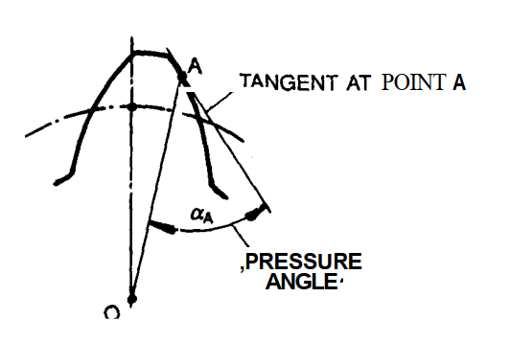
Terms Used in Gears
19. Pressure Angle
If a tangent is drawn to the involute profile of a tooth at any point on the curve and if a radial line is drawn through this point of tangency, connecting this point with the centre of the gear, then the acute angle included between this tangent and the radial is defined as the pressure angle at that point.

Slide 18
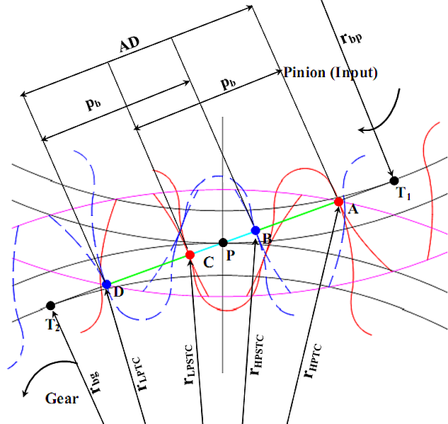
Tooth Engagement Positions in NCR spur gear drives
A – Lowest Point of Tooth Contact
B – Lowest Point of Single Tooth Contact
P – Pitch Point
C – Highest Point of Single Tooth Contact
D – Highest Point of Tooth Contact
Normal Contact Ratio GEARS : 1<contact ratio (ε) <2
For example : contact ratio =1.6
AB –Double Pair Contact Region
BC –Single Pair Contact Region
CD –Double Pair Contact Region

Slide 19

Conjugate action and law of gearing

Slide 20
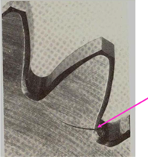
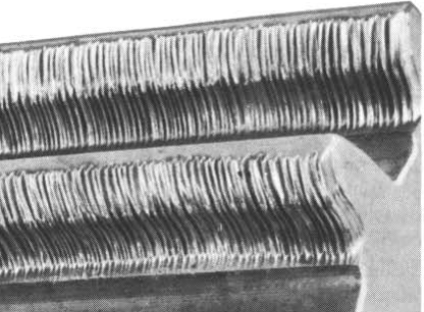
Gear tooth Failure
Gear tooth failure
1. Tooth Root Crack – Inadequate bending strength
2. Wear – Inadequate contact strength
Tooth surface wear
Tooth root crack

Slide 21
Spur Gear Design- Problem
Two spur gears are to be used for a rock crusher drive and the number of teeth of the pinion is 20. Gears are to be designed for the following requirements., Power to be transmitted 18KW, speed of the pinion 1200 rpm, angular velocity ratio or gear ratio 3.5, tooth profile 20º full depth involute. Assume that gears made of case-hardened alloy steel. Design the drive. Both the gears are made of same materials. The life of the gear is 20,000 hrs. The Rockwell hardness of the material is 55 HRC and HB>350.

Slide 22

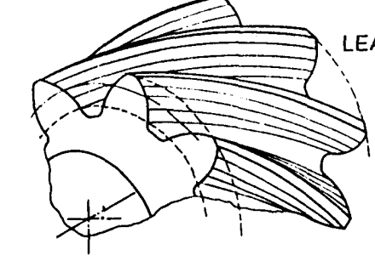
Helical Gears
When a pair of parallel helical gears mesh, the following conditions must be satisfied for proper running of the set:
(i) The gears must have helix angles of equal value; (ii) The gear teeth of each member must have the same module, and (iii) The gear teeth of each member must have opposite helices, that is, one gear must have right-handed helical teeth while the other must have left-handed ones.

Slide 23
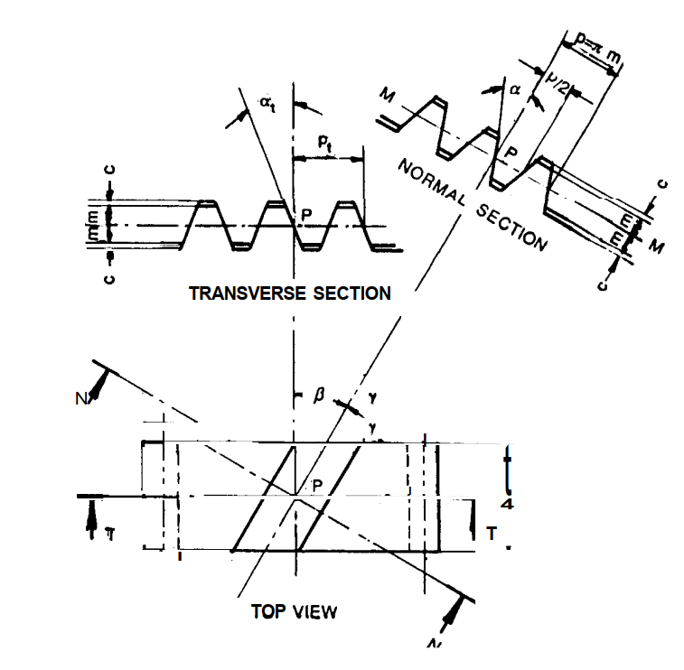
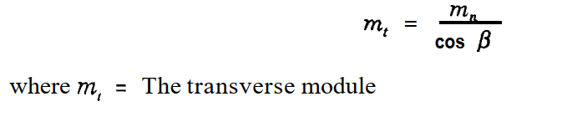

Helical Gears
Helix angle : This is the angle which the tooth trace of a helical gear in the pitch plane makes with the gear axis.
The two pressure angles are related thus:

Slide 24

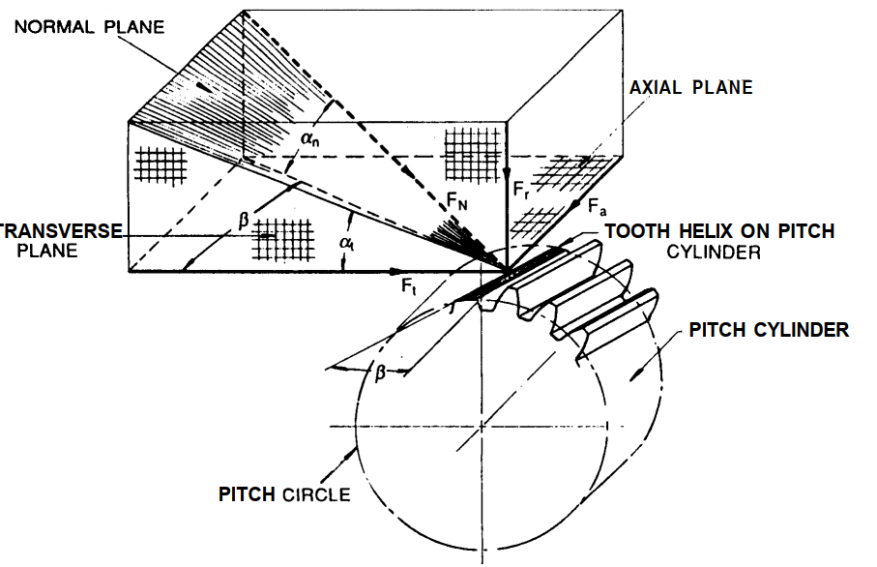
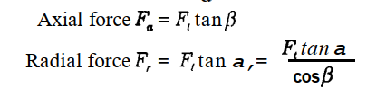
Helical Gears
Virtual number of teeth

Slide 25
Helical Gears
A pair of helical gears transmits 37.5kW at 1750 rpm. The speed reduction ratio is 4.25 and the helix angle is 15º. The service is continuous and the teeth are 20º FD in the normal plane. The number of teeth of the pinion is 20. Assume that gears made of case-hardened alloy steel. Design the drive. Both the gears are made of same materials. The life of the gear is 10,000 hrs. The gear drive is a closed type. The Rockwell hardness of the material is 55 HRC and HB>350. Take E=215GPa, [σ_{b}] =270 N/mm² and [σ_{c}] =901 N/mm²

